Slide 1
Item 7: Innovative Pedagogy Showcase A Sharing Session on Service Learning
Joint Presentation by
Dr. Nancy Guo• Dr. Simon Wang • Dr. Joshua Chan
September 2025

Slide 2
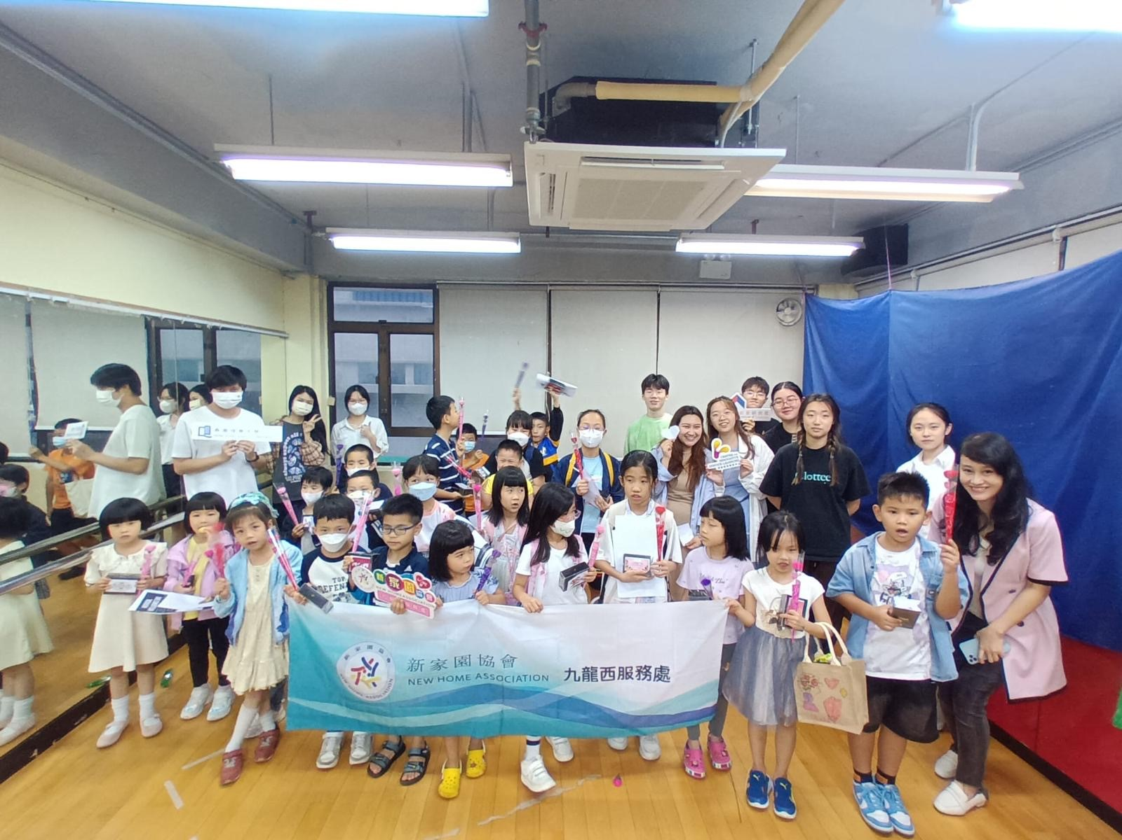
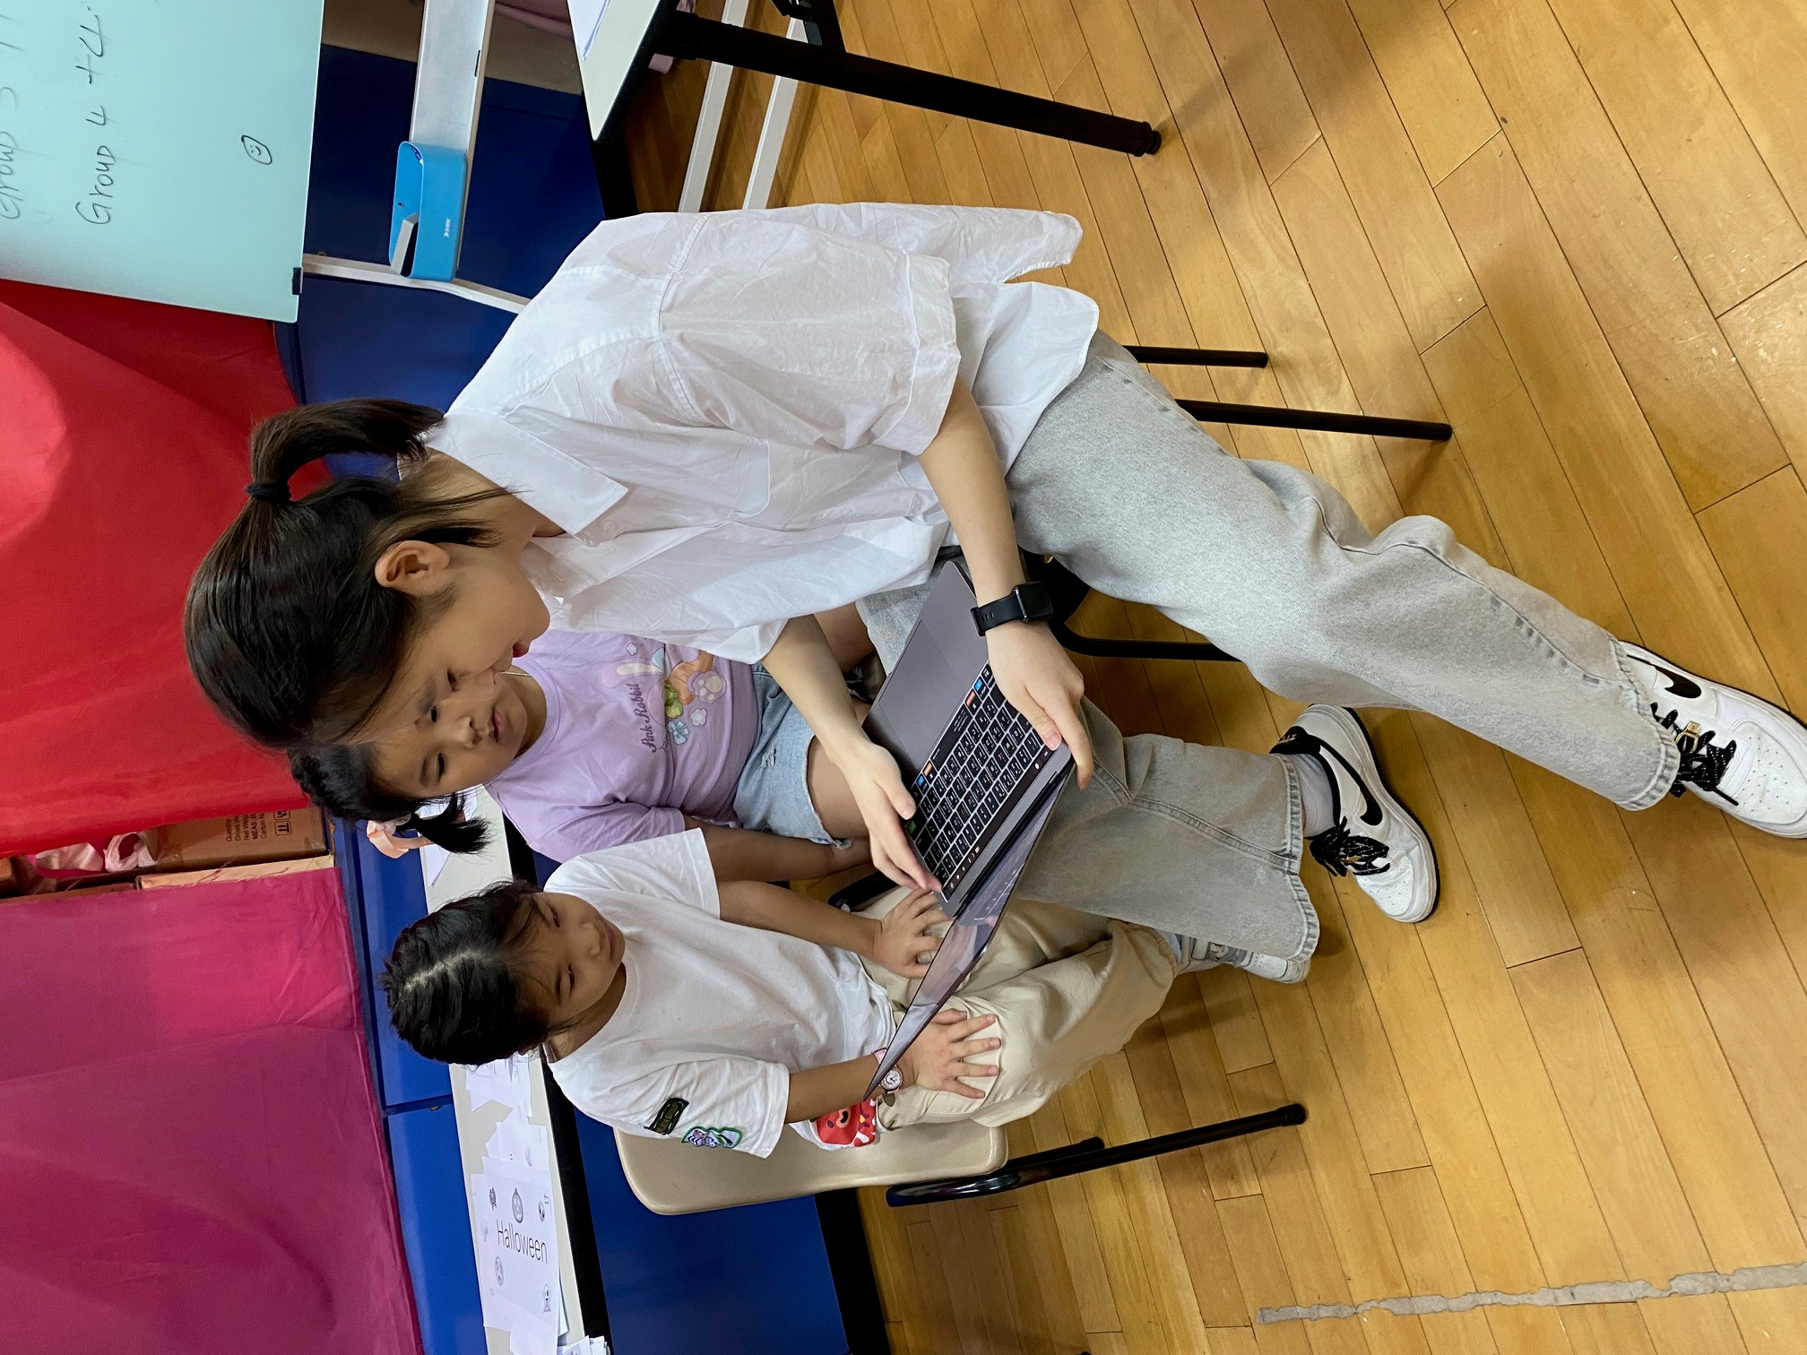
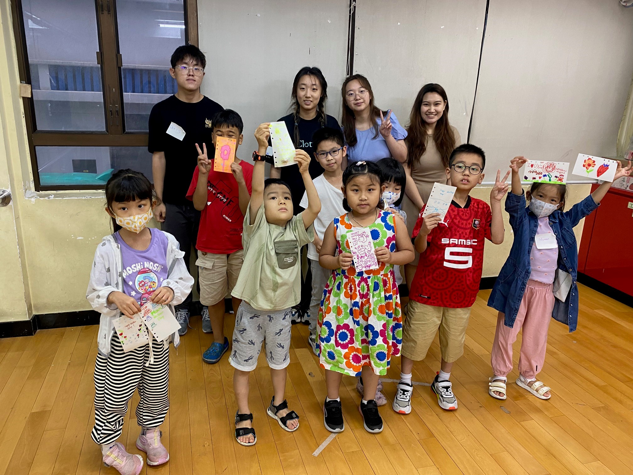
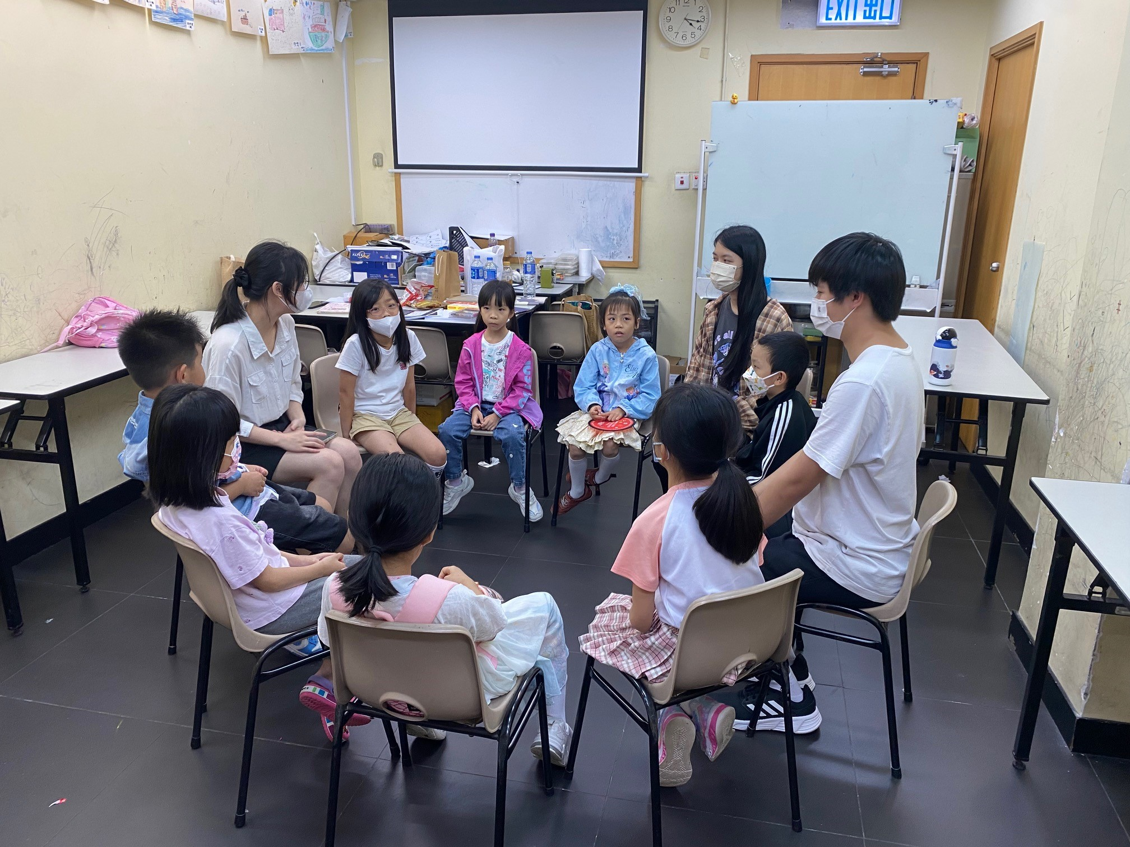
Teaching Primary School Students English with the Help of AI (Nancy & Simon)
• 10 HKBU students.
• 60 Primary School Students from New Home Association in Sham Shun Po.
• Groups of 3-4 HKBU students were assigned to teach 10 primary school students in each session, with a total of two sessions conducted.
• Pre-service training workshops, service delivery & post-service reflective sessions.
• Students are encouraged to apply their learning by designing interactive English workshops for underserved students at community centres.

Slide 3
Dr. Simon Wang: LANG 2077
• Language Skills for Human-AI Partnership
• AI-Assisted Language Learning
• Critical Digital Literacy
• Service Learning Integration
• Student Engagement & Outcomes
• Future Directions

Slide 4
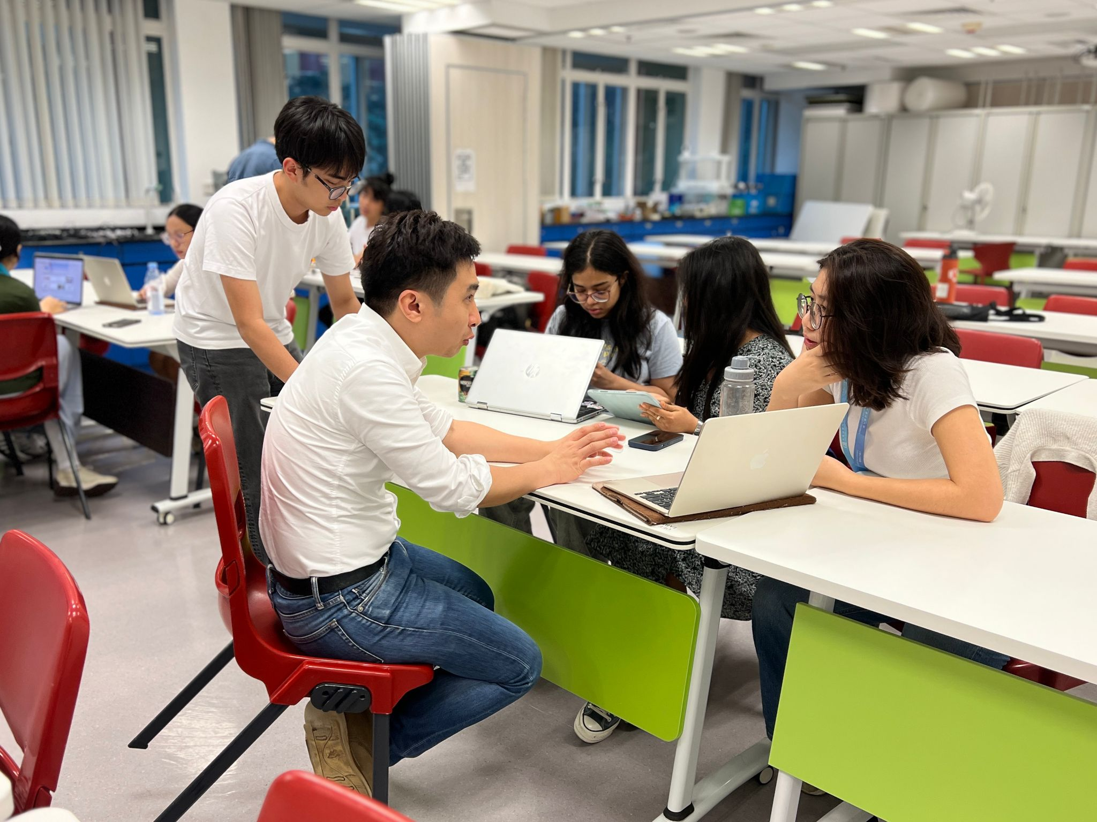
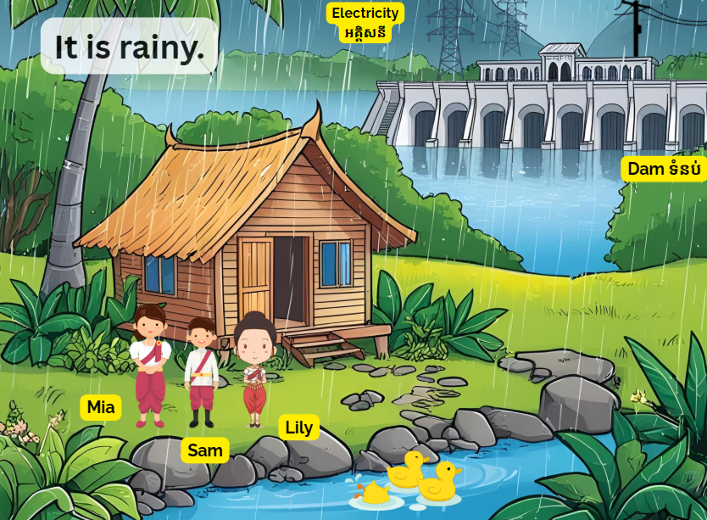
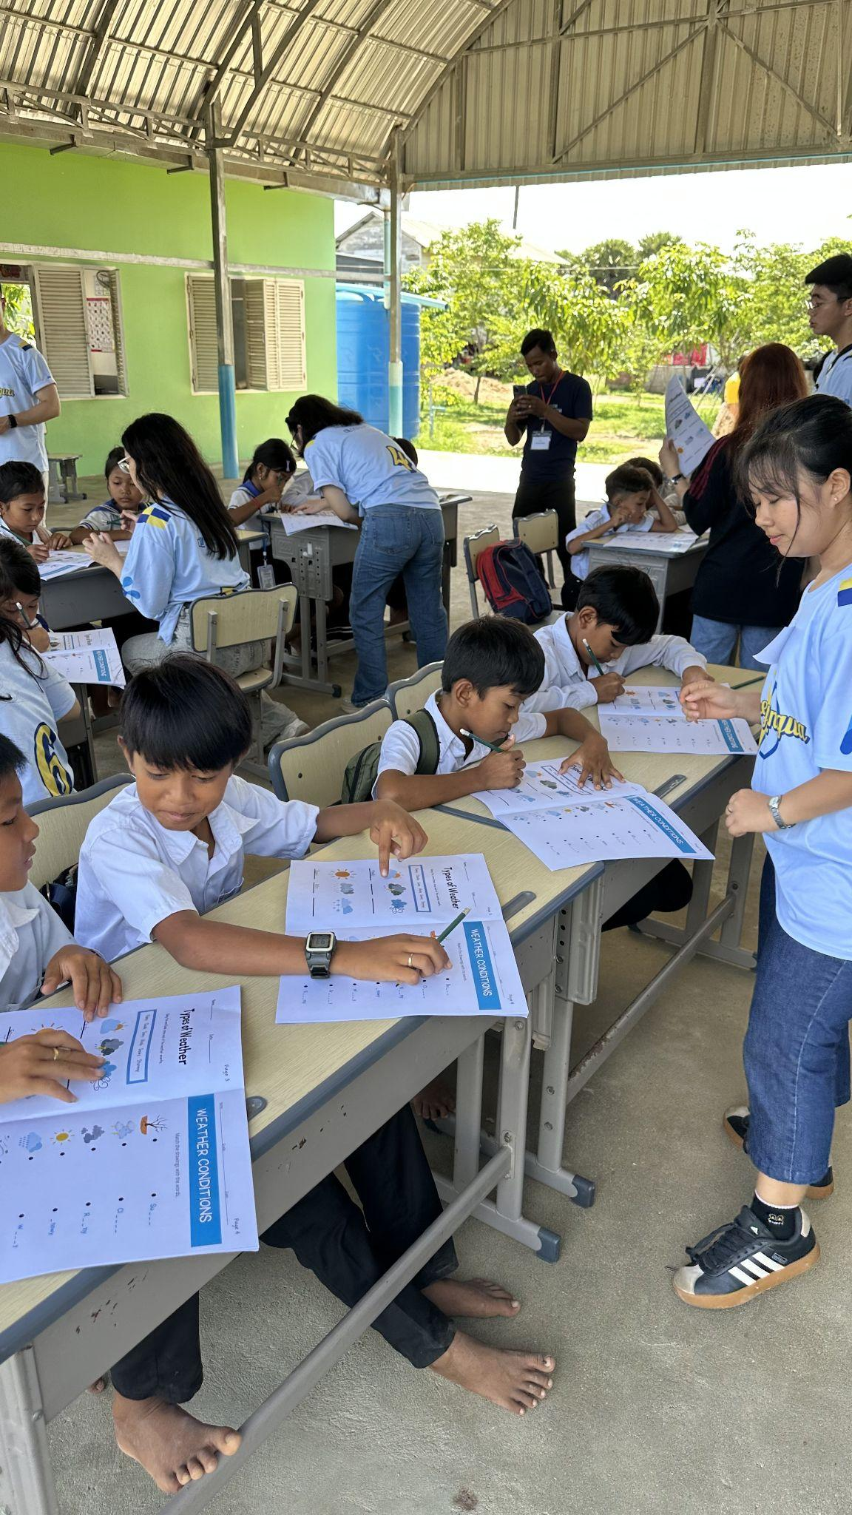
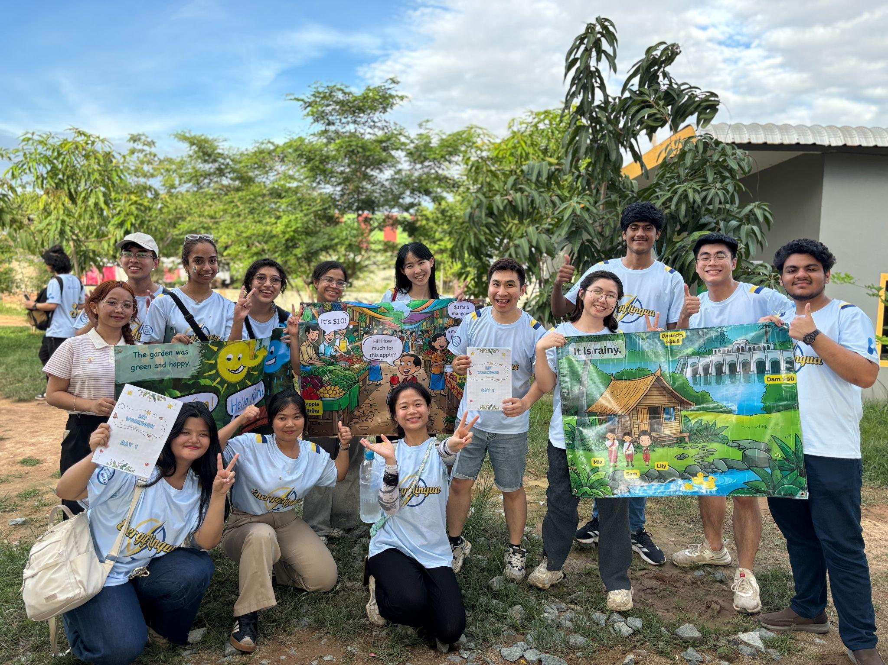
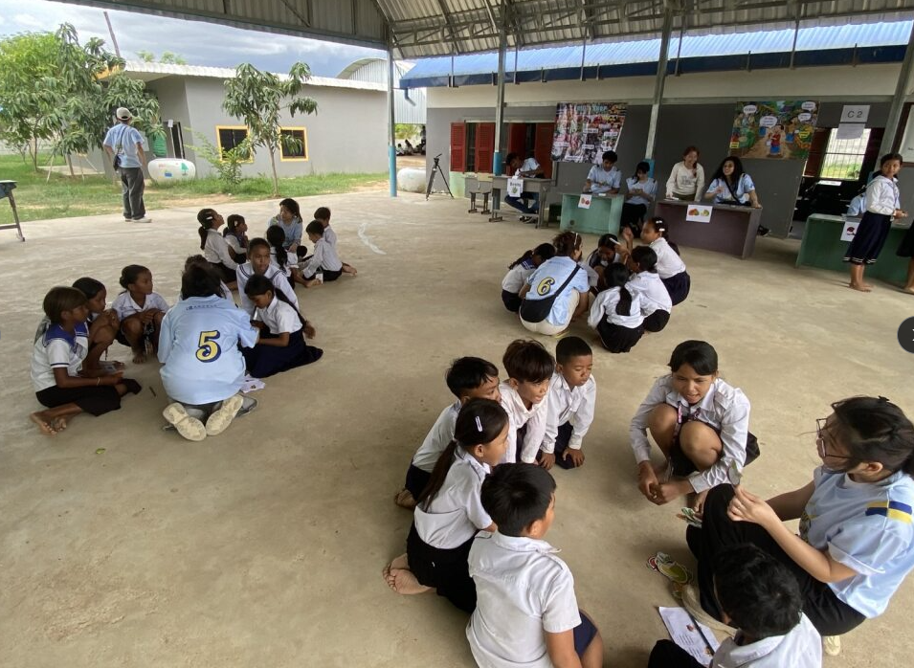
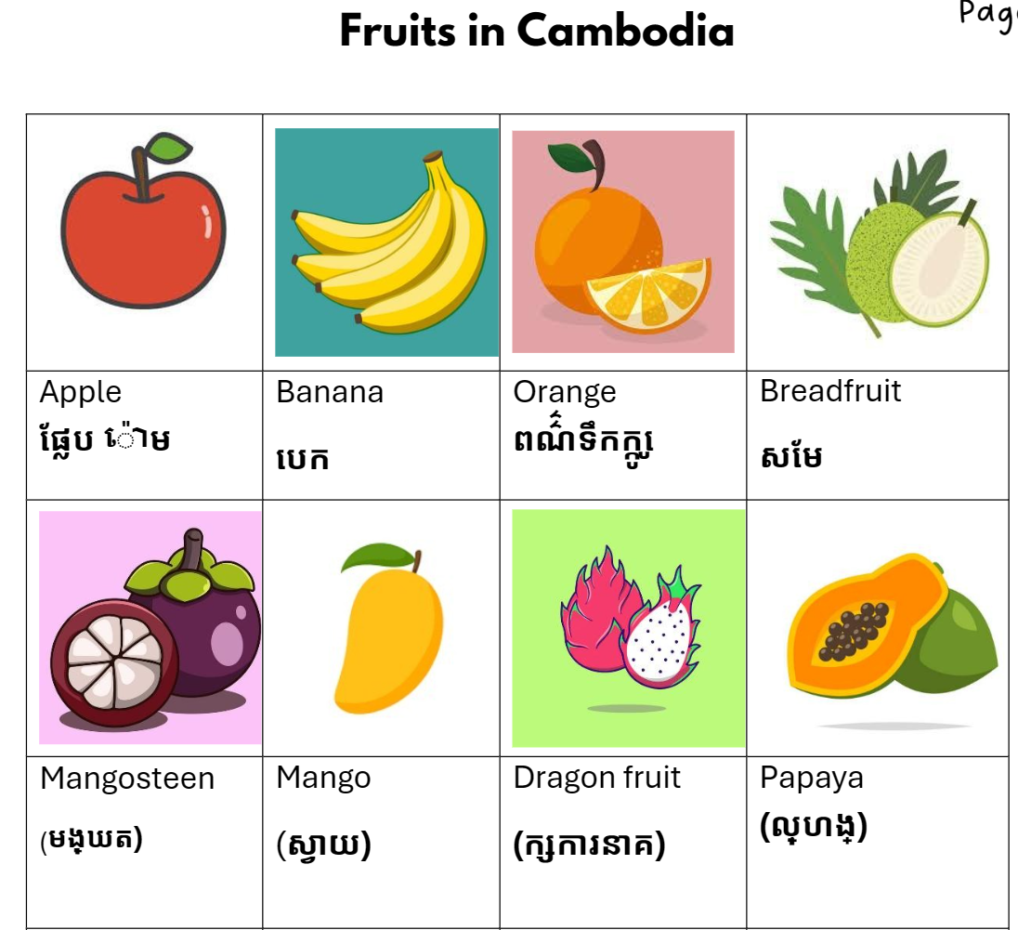
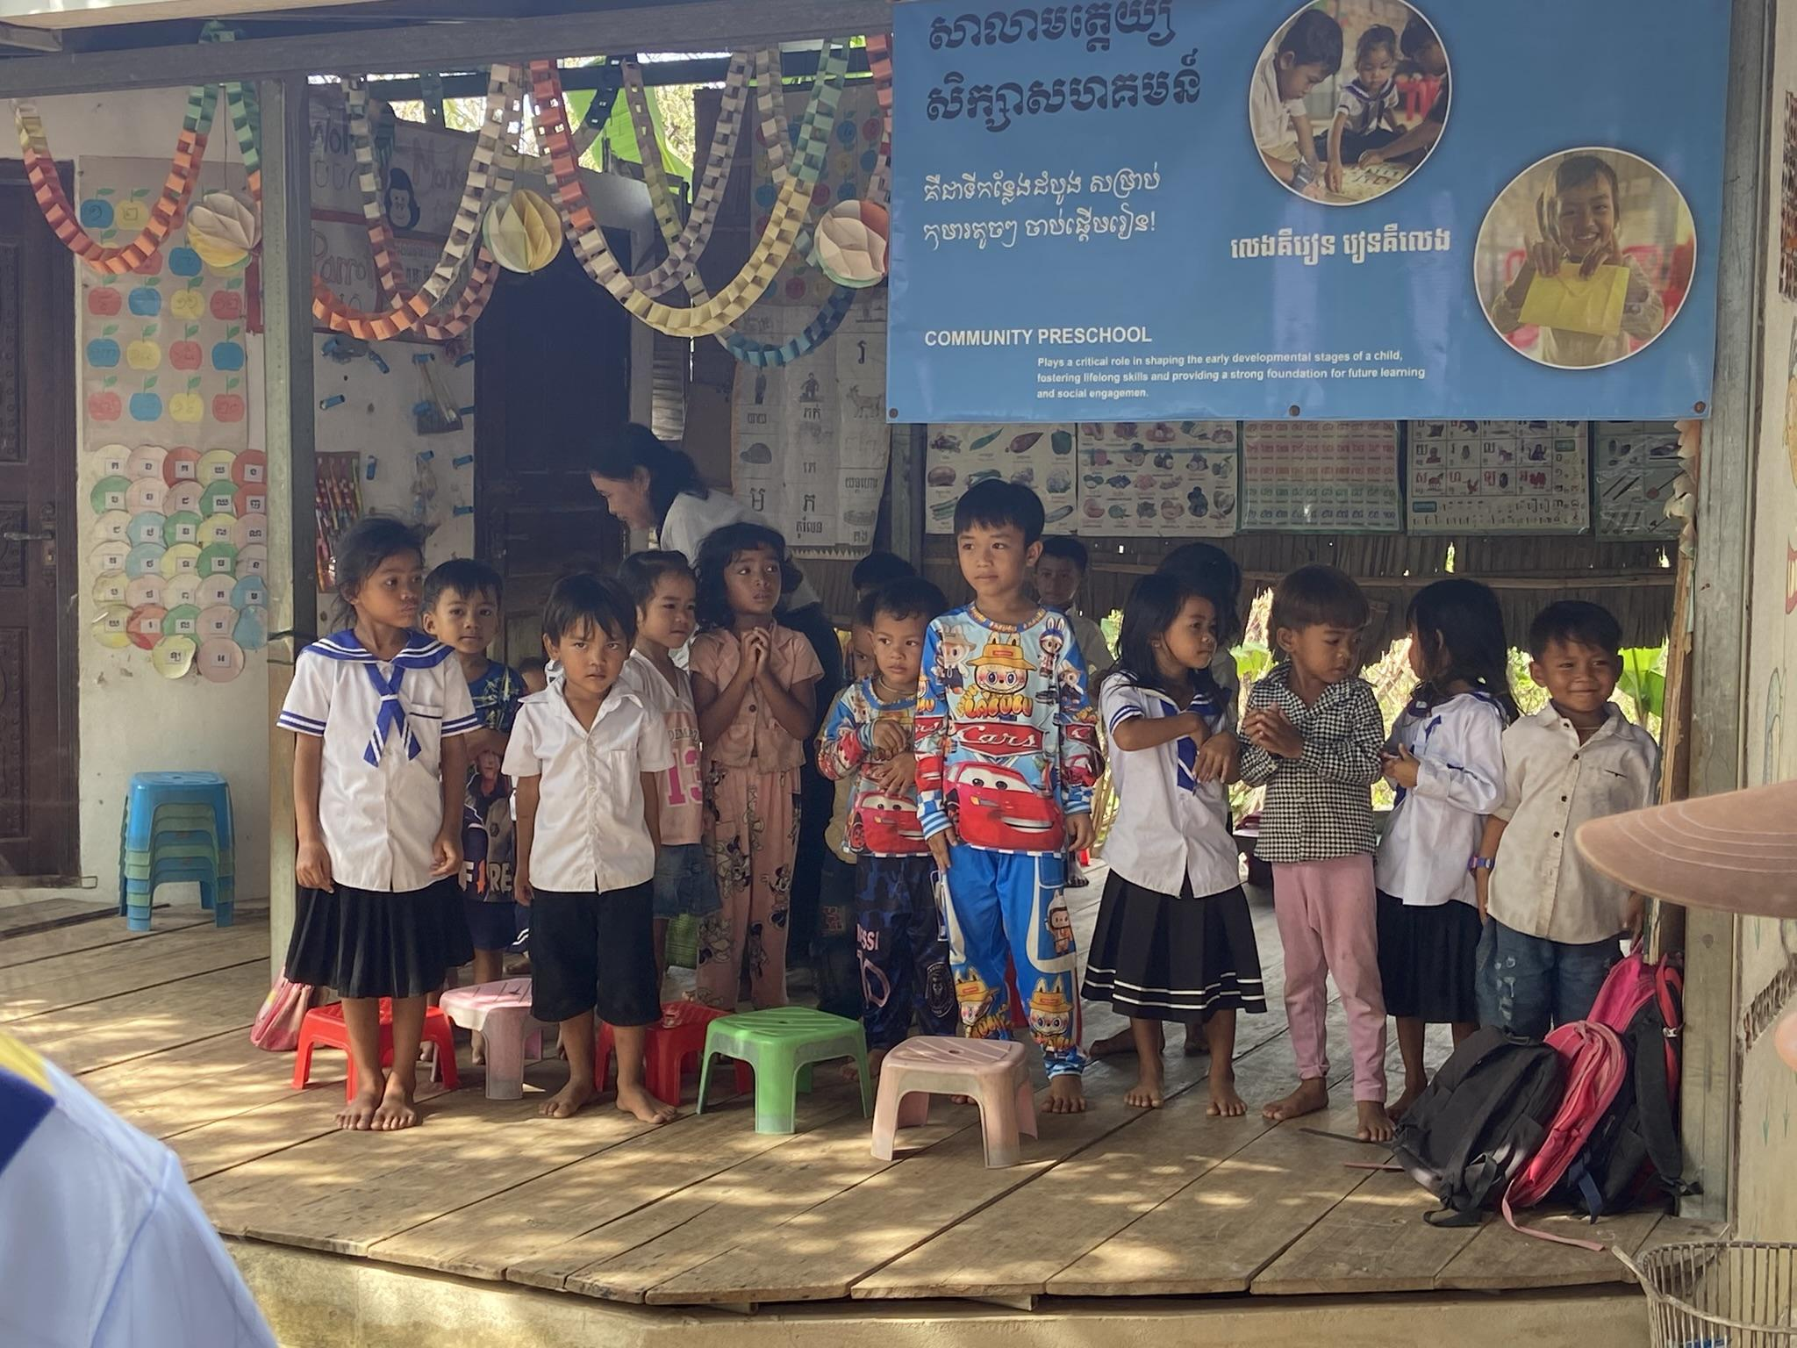
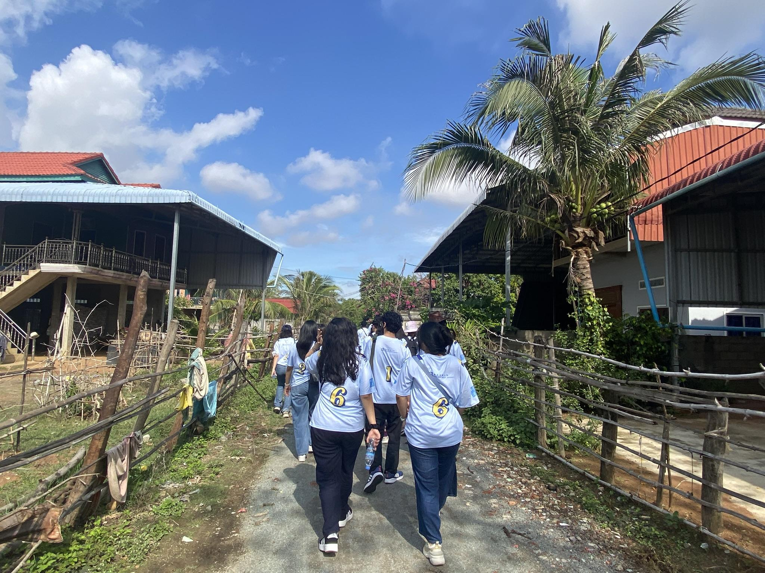
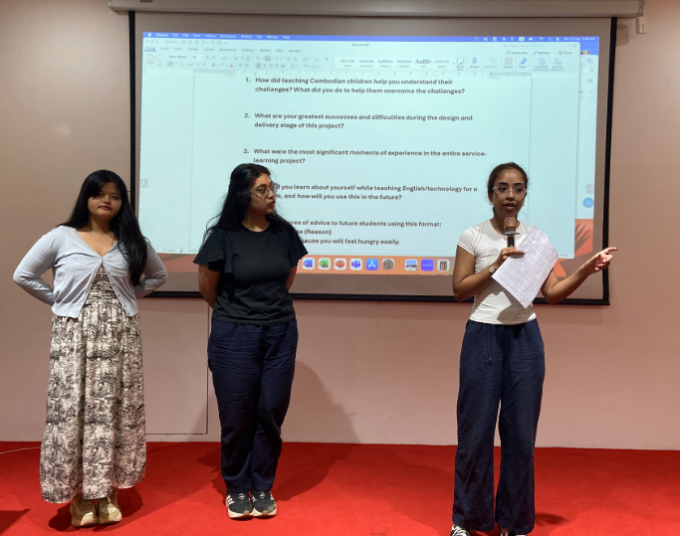



Engaging communicative activities for service-learning abroad (run as a project in 2025)
Experiential learning
Immersing 11 HKBU students in hands-on teaching of green energy and language in Cambodia; learning from observing, from correcting mistakes, from getting close to history, and from interacting with locals.
Situated learning
Situated learning occurs as students apply knowledge in the real-world context of Motherland Cambodia Education Center, learning to integrate language with green energy education and cultural practices, and learning to adjust teaching strategies.

Slide 5
Thank You & Discussion
• Questions & Answers
• Collaborative Opportunities
• Future Service Learning Initiatives
Contact:
Dr. Joshua Chan | Dr. Nancy Guo | Dr. Simon Wang
HKBU Language Centre

Slide 6
Online screening test
A platform for running online language proficiency tests on the 4 skills
developed in-house by an external consultant
…

